Slide 1
China's Next Chapter: Regulatory Trends & Economic Implications
Weisi Xie
Shanghai Director
Economist Intelligence Corporate Network
weisixie@economist.com
January 2026

Slide 2
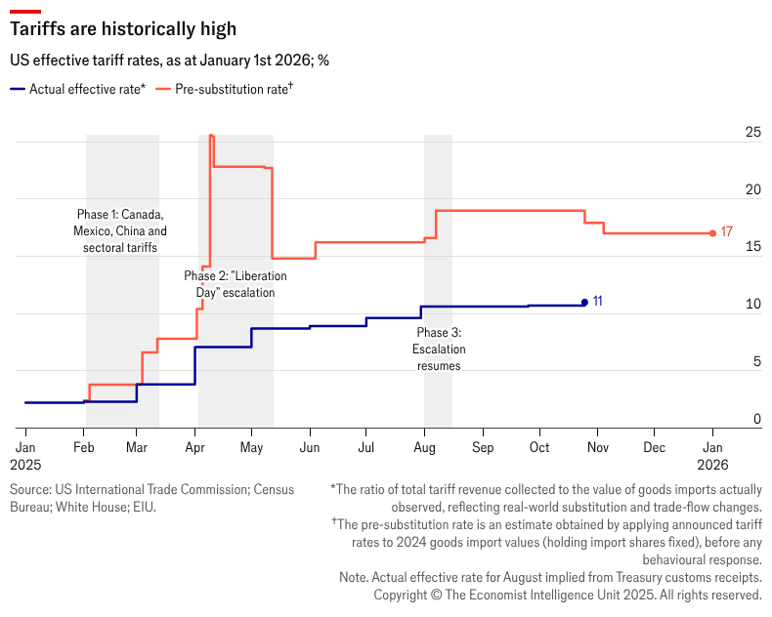
The US trade policy remains the largest source of global uncertainty
The "Year of the Tariff" has moved past its initial shock-and-awe phase into a period of institutionalization
The universal IEEPA reciprocal tariffs now range from 10% to 41%
A ruling of its legitimacy by the Supreme Court is expected by mid-2026;
If invalidated, the administration has prepared “Plan B” to maintain tariff pressure at 15% to 50%;
If upheld, the executive branch will seek to make the rates permanent at 15%-20%.
Sections 301 and 232 tariffs are imposed at rates between 10% to 50% for enforcement against unfair trade and national security-linked industrial protection
Key product categories include: semiconductors, steel and aluminum, copper, lumber; automobiles and parts, MHDVs, maritime equipment; household appliances; Iran, Russia and Brazil-related/connected trade; etc.
Sectors under investigation: pharma & medical equipment; commercial aircraft & engines, drones, robotics; wind turbines; EU luxury; etc.

Slide 3
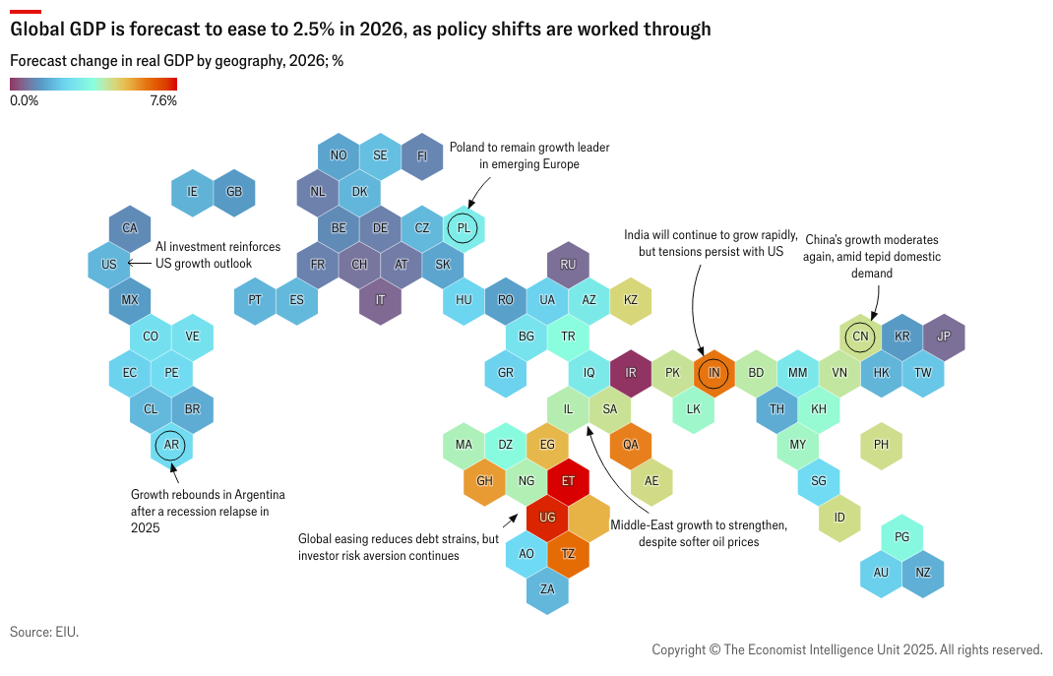
The global economy will moderate to 2.5% in 2026 from 2.6% in 2025
The weakest performance since 2020

Slide 4
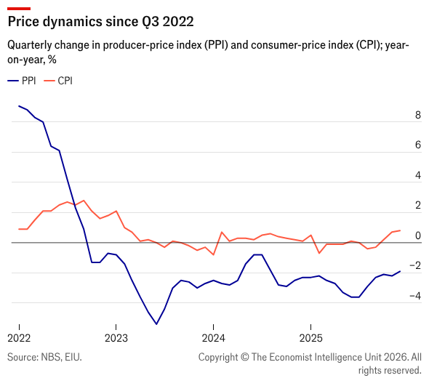
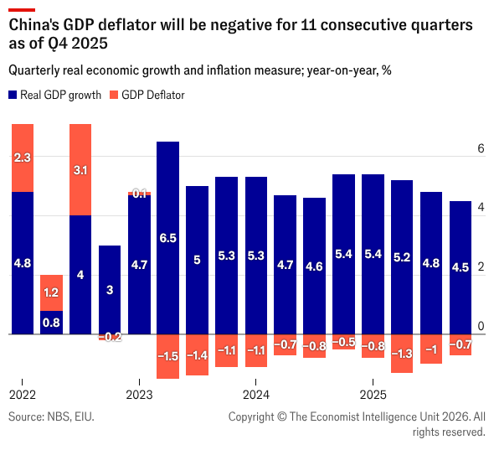
What happens within China might be more important
China grew by exactly 5% in 2025, but deflationary pressure will remain elevated

Slide 5
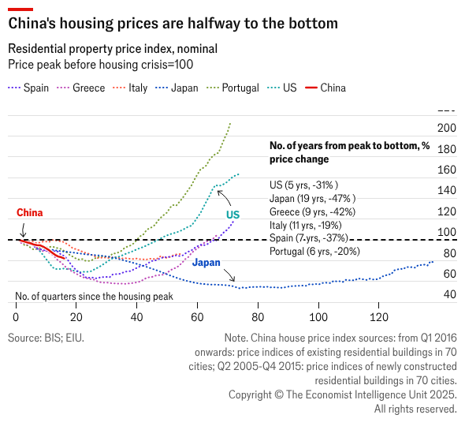
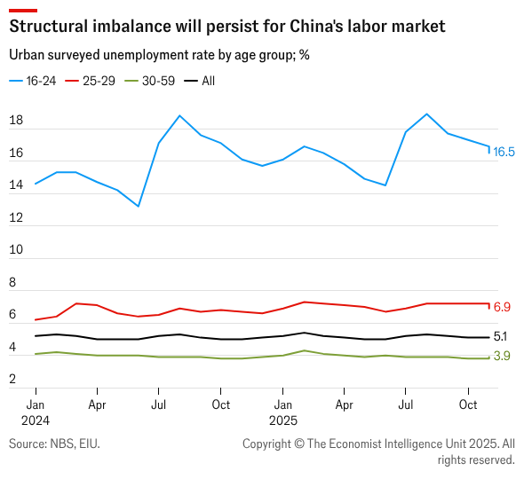
Structural drags on the demand side are deteriorating
Property prices continue to tumble albeit at a slower pace and labor market pressure for the youth will remain elevated

Slide 6
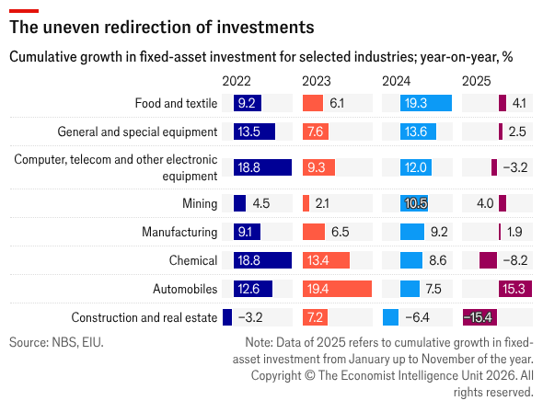
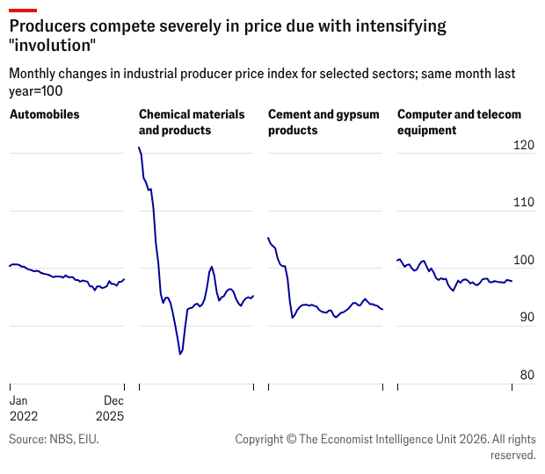
Property crackdown has redirected investments into other sectors…
…which leads to pervasive overcapacity across a wide range of industries
The government has launched large-scale anti-involution campaign to address industrial overcapacity, but the progress will be slow

Slide 7
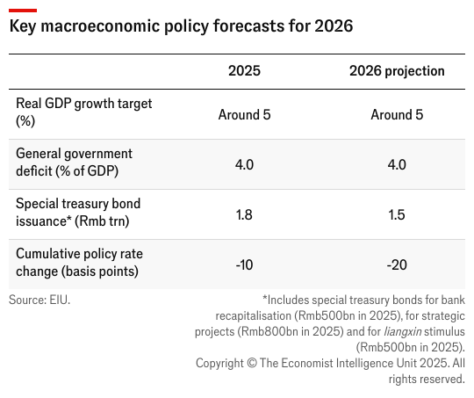
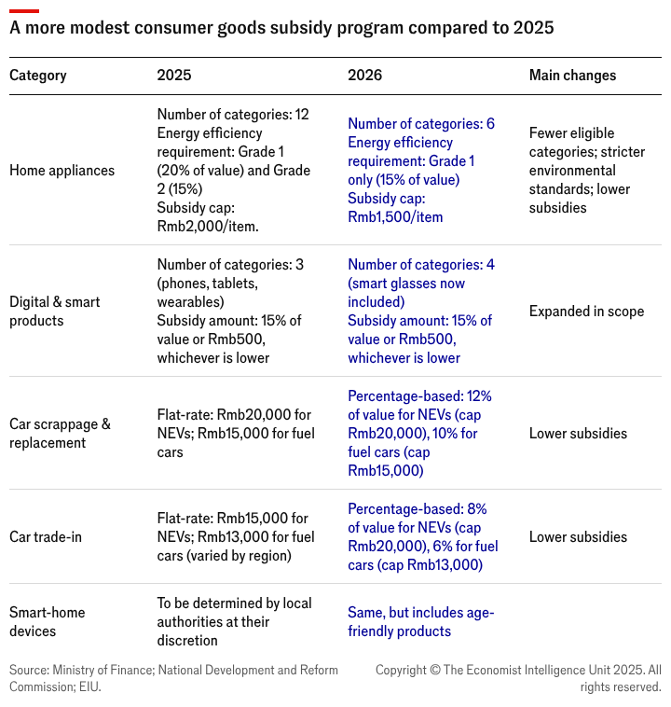
What to watch in 2026: what are China’s policy directions?
Public investment will resume and consumption subsidies are likely to be smaller in size

Slide 8
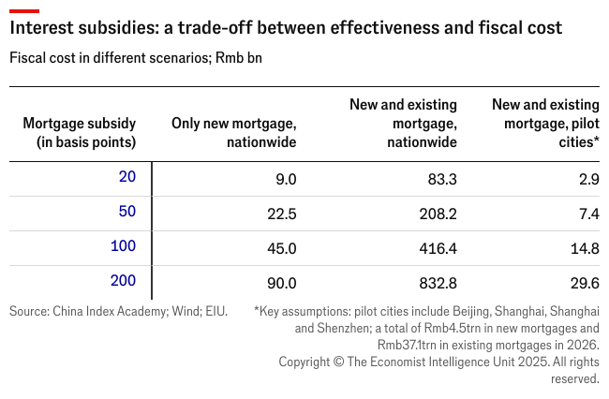
What to watch in 2026: what property stimulus measures could be expected?
The likelihood of policy support in 2026 is rising, but actions will remain measured and incremental.
We expect modest, 20-basis-point cumulative cuts to China’s policy interest rate in 2026,
Fiscal subsidies to mortgage interests would not exceed Rmb100bn,
We still do not expect a full removal of restrictions in core areas in Beijing and Shanghai at least in 2026,
We do not see any possibility of a government-led bailout for developers in 2026, as the risk of a systemic financial crisis is still manageable.
The emphasis of China’s property policy is being placed on improving livability: affordable housing construction, urban renewal and shanty-town renovation.

Slide 9
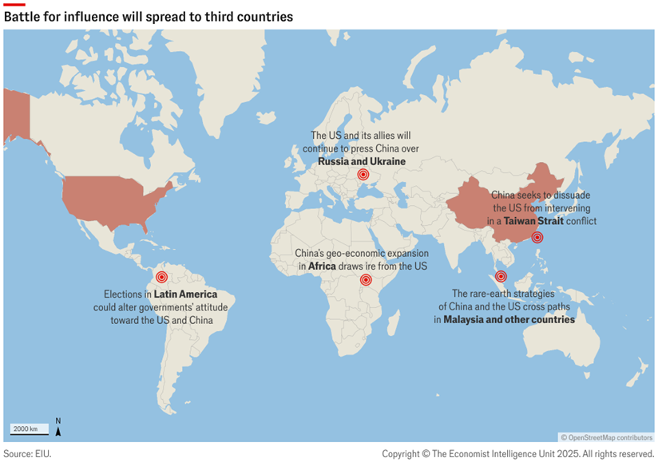
What to watch in 2026: a half-time break from US-China confrontation
US’s weighted average tariff rate (WATR) on China is expected to stabilize at 20-30%, from 38.6% as at July 2025
Both countries are economically motivated to manage the conflict in 2026
The US economy will work unfavorably for President Trump ahead of the midterm elections in Nov.
External stability will help China as the country strives for another year of steady growth amid feeble private-sector vigor.
Rivalry will not die away, but will instead unfold in more indirect forms
China’s commitment to self-sufficiency will add momentum to the domestic substitution of US components, even among private firms.
Third countries will become increasingly important battlegrounds for influence.

Slide 10
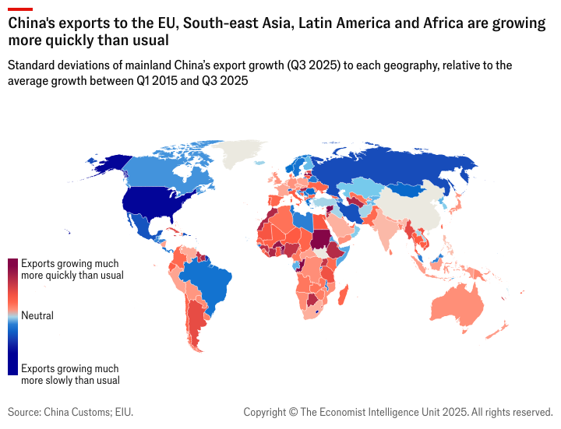
What to watch in 2026: will the world go against Chinese imports?
China will push for rebalancing at its own speed, without compromising to external pressure
The influx of Chinese imports will be in the spotlight across many geographies
With China’s industrial overcapacity set to consolidate only gradually the country's manufacturers will have a strong incentive to explore other markets.
The shrinking tariff disadvantage of China is likely to entail a decline of transshipment of US-China trade.
The EU will exert greater pressure on Chinese imports
The recent EU-China price deal will be a partial solution to prolonged tensions over EVs.
Trade disputes will also emerge in low-value e-commerce shipments and other areas.

Slide 11
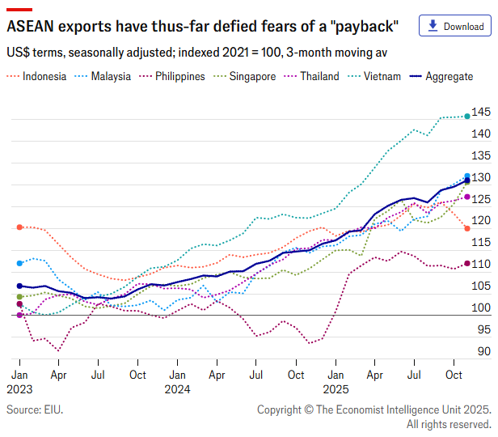
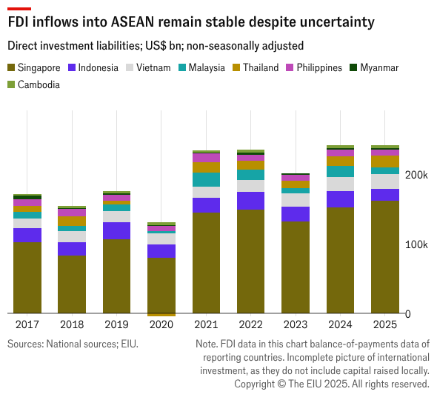
What to watch in 2026: ASEAN as a hotspot of APAC
“China+1” diversification remains intact but will evolve with firms adopting dual supply-chain systems

Slide 12
Closing – strategic reflections (ABOS results to be added…)
A. Efficiency pivot
B. “China-native” transformation
C. China as springboard
Engaging in defensive restructuring to protect margins in traditional segments, accepting that top-line growth is no longer the primary metric of success.
Prioritizing profit (over growth)
Workforce and operational streamlining
Accepting the “China price” to compete locally
Dual branding strategies
Dismantling the traditional HQ-hub-spoke model and empowering China operations to function with greater speed, autonomy, and localized supply chains.
Radical R&D localization (local 0 to 1 innovation)
Supply chain insulation (localizing for speed and access, not just cost)
Granting local autonomy
Dual-tech stacks
Flipping the narrative from "China as market" to "China as global engine”, using China experience and footprint to drive competitiveness in other markets.
Strategic ecosystem partnerships (to access “new China” growth pockets)
Reverse learning (China as internal “fitness center”)
China as low-cost, high-tech export hub
Expanding in partnership with China Inc. (into third markets)

