Slide 1

ꢀ MioTech All Rights Reserved-Do not duplicate or distribute without permission.
INNOVATE FOR A
SUSTAINABLE FUTURE

Slide 2

Who we are
MioTech is a
sustainability,
data, and
18
10
Our datasets cover markets totaling over
trillion USD
We serve clients with over
trillion USD in AUM
technology
provider focused
on Asia.
ꢀ MioTech All Rights Reserved-Do not duplicate or distribute without permission.

Slide 3
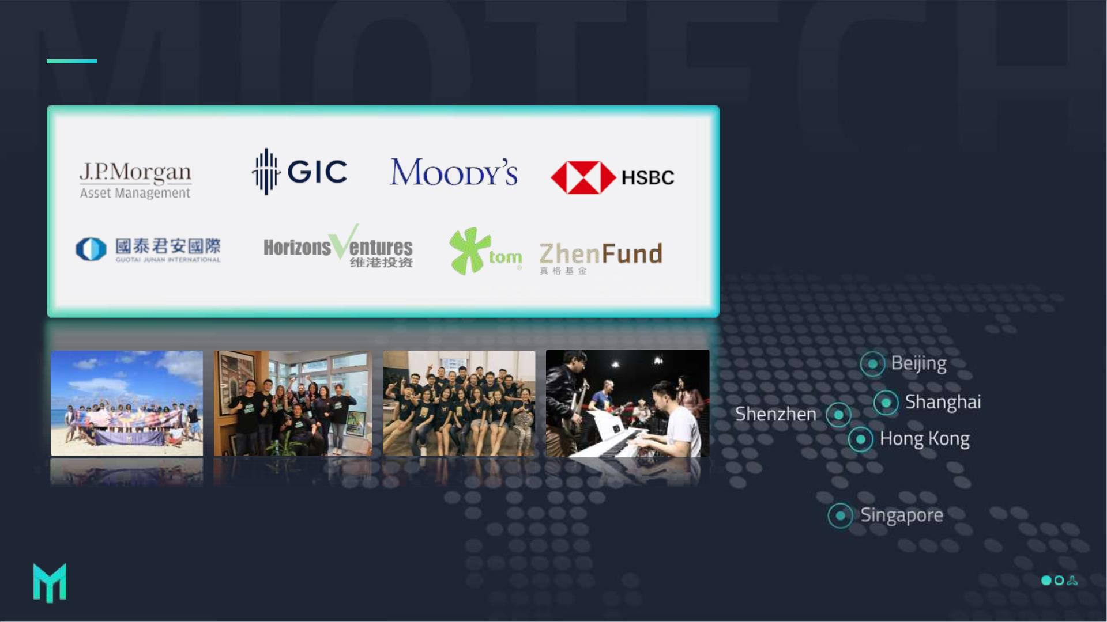
Who we are
ꢀ MioTech All Rights Reserved-Do not duplicate or distribute without permission.

Slide 4
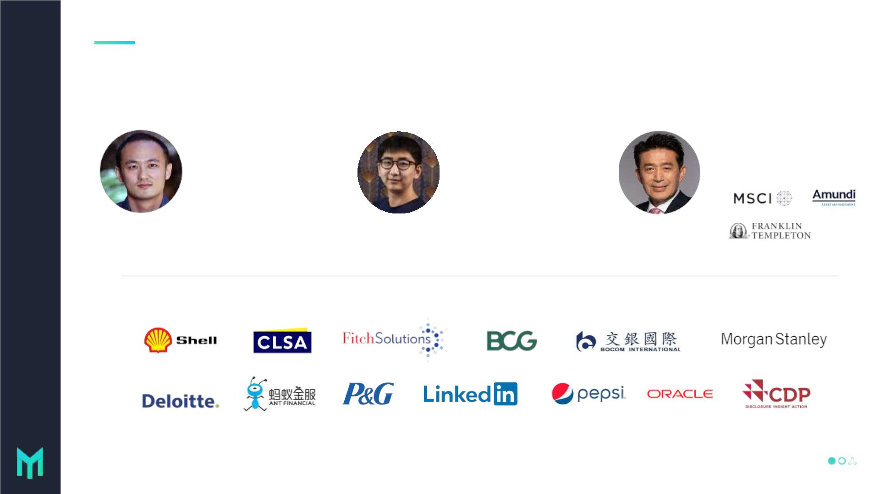
Meet the team
Our team consists of finance and technology talents from world-renowned insitutions
in Silicon Valley, Wall Street, Hong Kong, and China. Of over 350 employees, 67% are
engineers trained in finance, artificial intelligence, ESG and carbon.
Jason Tu
Tao Liu
Jack Lin
CEO
CTO
President
Stanford MBA, led multiple
teams in Standard Chartered
Bank, WeLab, and Robinhood
Cornell CS Master, specialized in
distributed database and data
infrastructure at Oracle and Turn
Other employee backgrounds：
ꢀ MioTech All Rights Reserved-Do not duplicate or distribute without permission.

Slide 5

What we do
ESG
Decarbonization
AMI
-- ESG Data & Ratings --
ESGhub
Carbonlens
Carbon Asset
-- ESG Reporting --
-- Carbon & Energy Tracking--
Development
Banking Solutions
ESG Indices,
Net Zero Consulting
Green Community
Methodology, Consulting
ꢀ MioTech All Rights Reserved-Do not duplicate or distribute without permission.

Slide 6

New technology for reliable carbon
accounting & reduction
ꢀ MioTech All Rights Reserved-Do not duplicate or distribute without permission.

Slide 7

Typical Net-zero Journey
Step 1:
ep 2:
ep 3:
ep 4:
ep 5:
Measure Carbon Inventory
inimize Waste
crease Energy
fficiency
estructure Energy
sage
CUS and/or
arbon Offsets
MioTech can help with your carbon
accounting and from there, identify
the carbon reduction opportunities to
set short-, medium- and long-term
targets to reduce emissions.
Our advanced calculations
and modeling help
corporations to identify
waste and take action to
reduce leaks and
Across business operations,
energy efficiency can be
increased by using special
technologies and materials
in facilities, production
plants, tools and equipment,
and by optimizing work
processes and methods.
Increasing use of renewable
energy in operations while
minimizing use of fossil fuel
will reduce overall GHG
emissions. Our CarbonLens
system enables enterprises
to accurately track and
Businesses can offset
unavoidable carbon
emissions through carbon
capture, utilization and
storage (CCUS) or trading.
This includes decarbonization roadmap
design, management system & capability
building, digital system deployment. .
wastages.
monitor carbon emission
reduction efforts in real time.

Slide 8

Net-zero Value Chains
Commercial or Industrial Groups
Brands & Supply Chain
⚫ top-down carbon emission & reduction
⚫ leading suppliers’ carbon emission & reduction
management to realize supply chain carbon
neutrality commitment & product carbon footprint
calculation
management across subsidiaries
Bank/Financial Institutions
Governments or Industrial Parks
⚫ leading portfolio’s carbon emission & reduction
management to realize scope 3 calculation and
control post-investment risks
⚫ leading the carbon emission & reduction
management of the companies within jurisdiction to
facilitate net-zero city/park building and propagandize
decarbonization culture

Slide 9

Major Challenges
01
03
Difficulty in acquiring
first-hand physical
data
02
04
Complex carbon
calculation schemes
Enormous emission
factors
Difficulty in reduction
opportunity
identification

Slide 10

Carbon and Energy Management software
Digital Decarbonization
Solutions
INNOVATE FOR A
ꢀ MioTech All Rights Reserved-Do not duplicate or distribute without permission.
SUSTAINABLE FUTURE

Slide 11

System Function Matrix
Carbon Management
01
02
Collect
Measure & Report
•
•
Provide flexible data collection combinations (IoT,
•
•
Embed international & domestic MRV standards &
parameter default values
API, bulk import)
Energy Management
Collect and monitor direct and indirect emissions in
real time reliably.
Calculate and report emissions upon one-click.
•
Energy Monitoring &
Alarming
03
• Energy Data Report
• Energy Data Analysis
• Energy Wastes Identification
• Energy Cost Management
• Renewable Energy
Management
04
Offset
Analyze
• Compare to historical and industry data for
benchmarking
Manage carbon asset development, trading and
•
• Understand emission trend, composition, distribution
and ranking.
compliance workflow at ease.
Manage reduction project and monitor operation
data.
•
• Detect hidden data and inefficiencies, prioritize
improvement opportunities
ꢀ MioTech All Rights Reserved-Do not duplicate or distribute without permission.

Slide 12
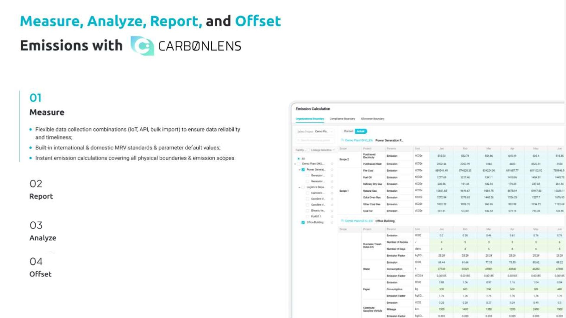

Slide 13
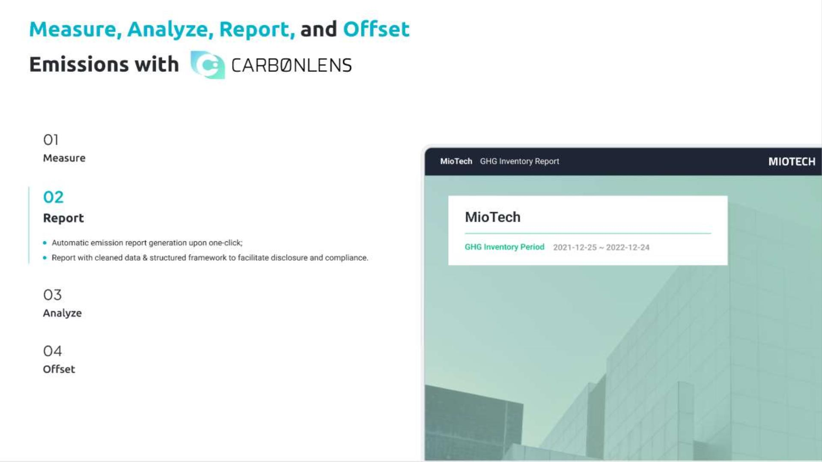

Slide 14
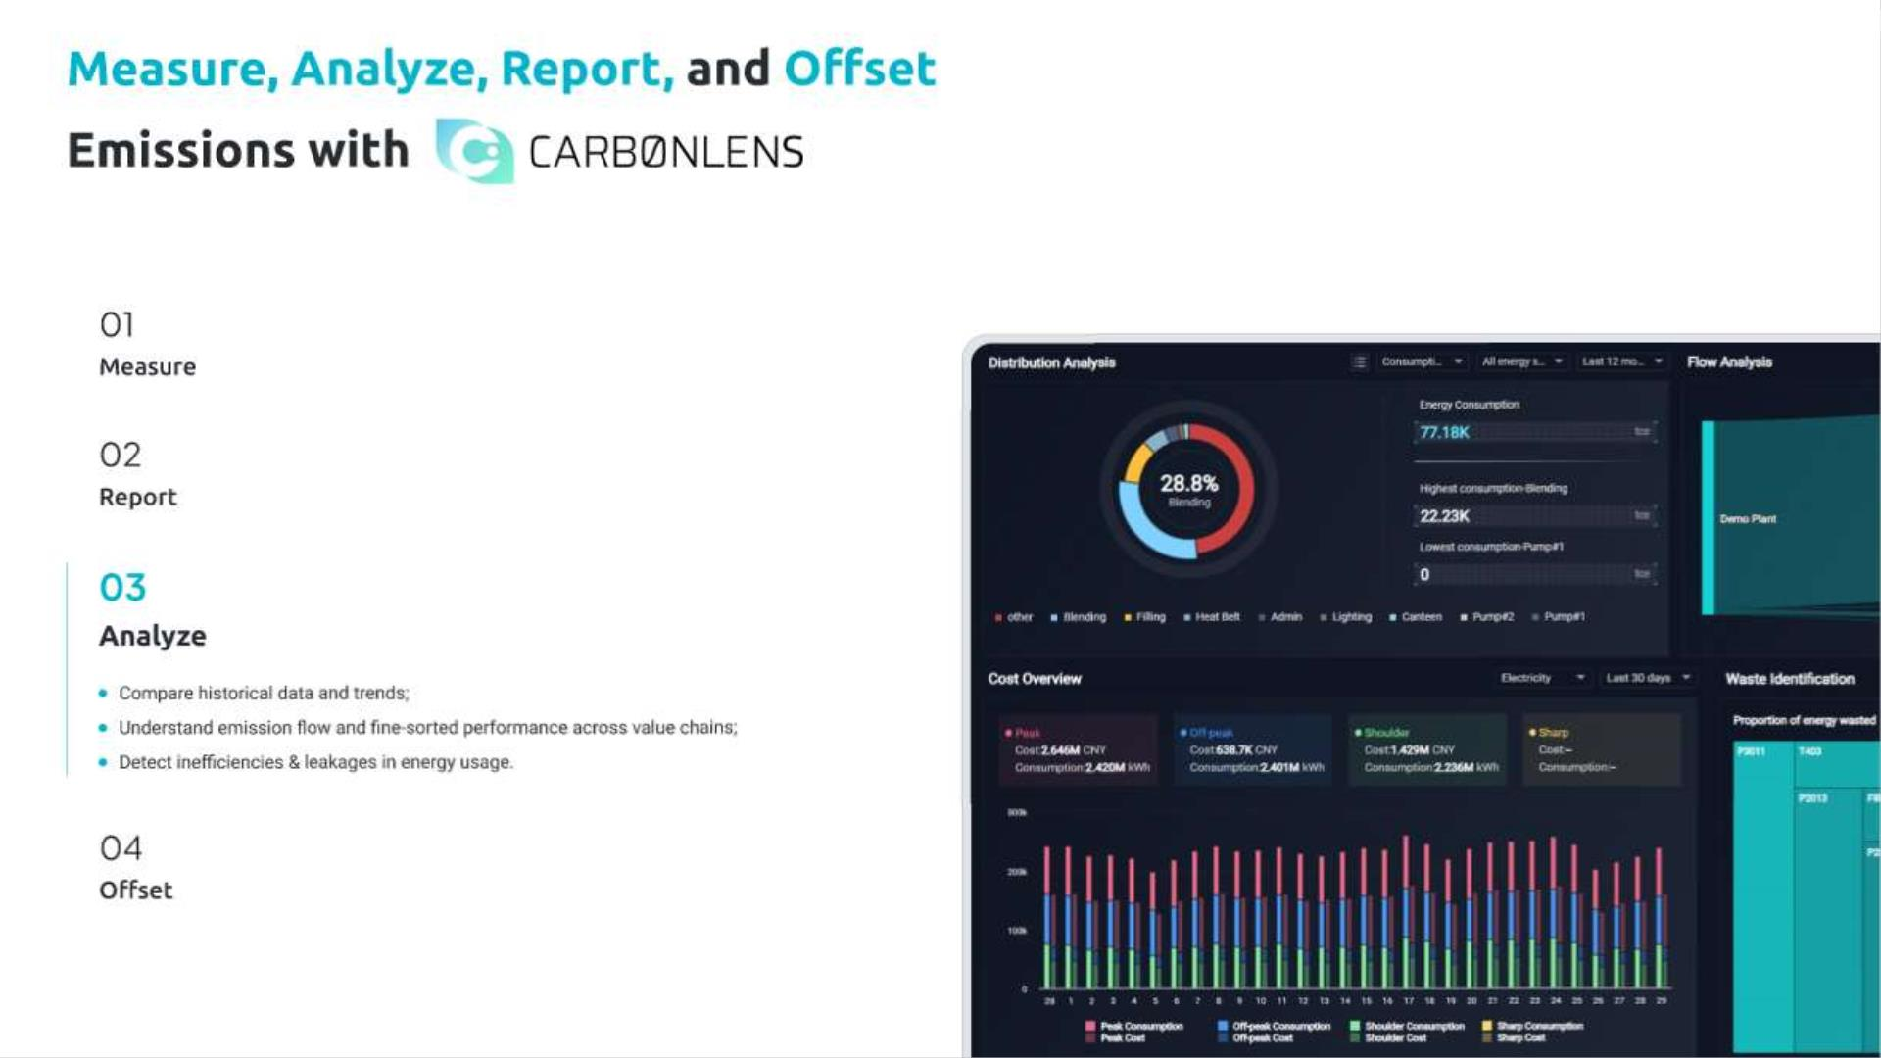

Slide 15
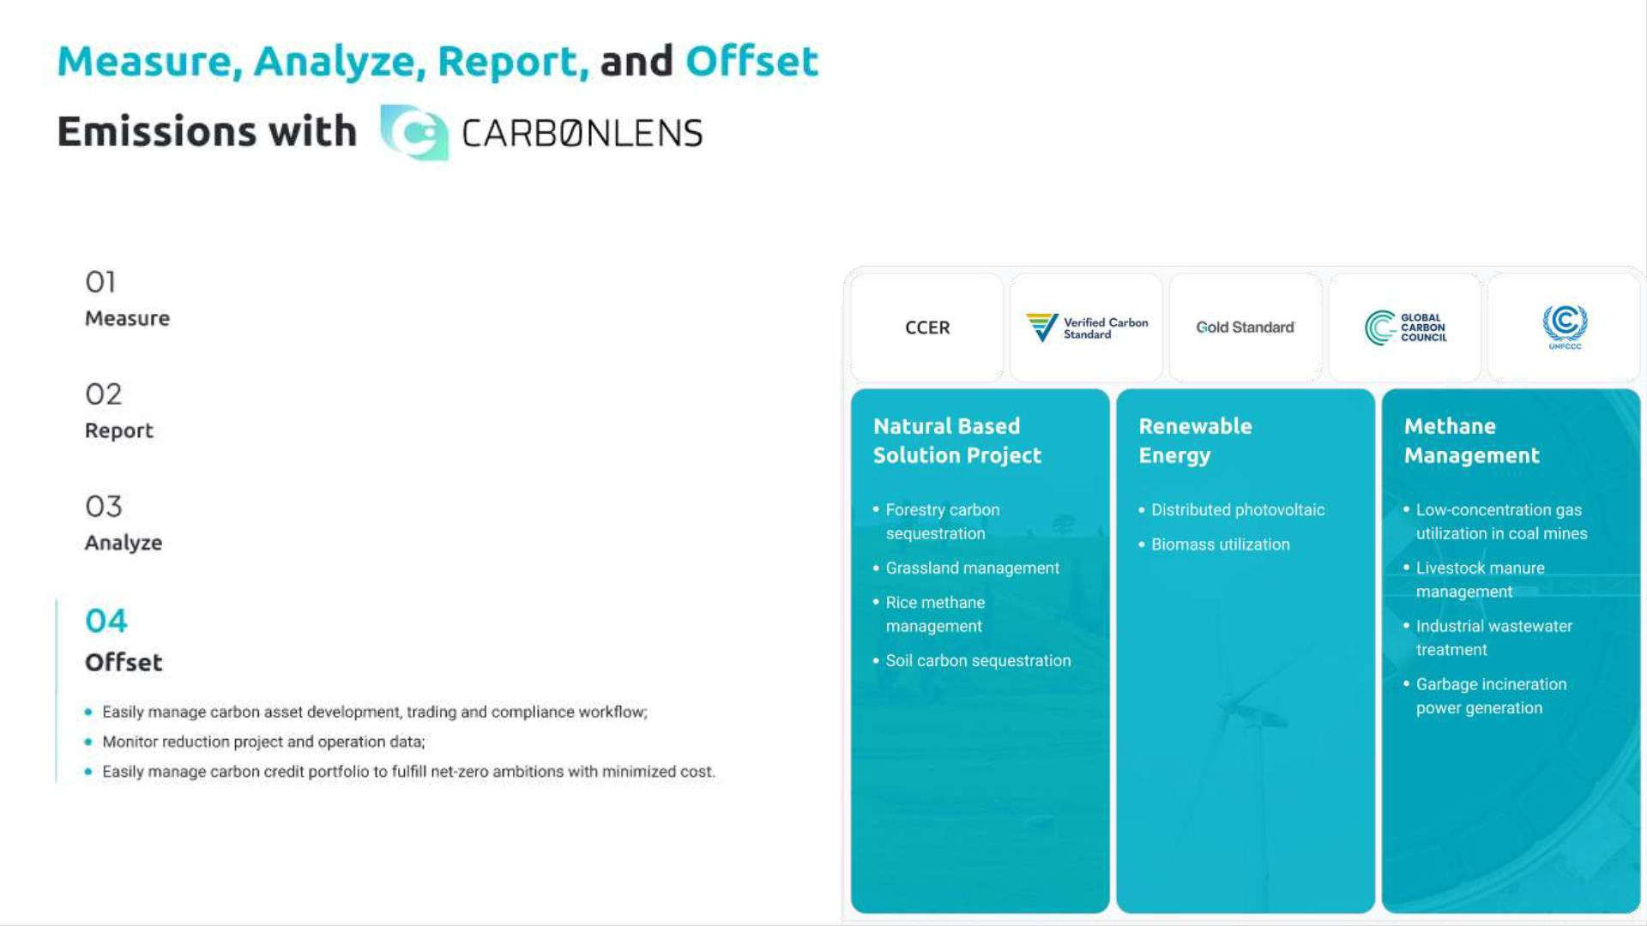

Slide 16
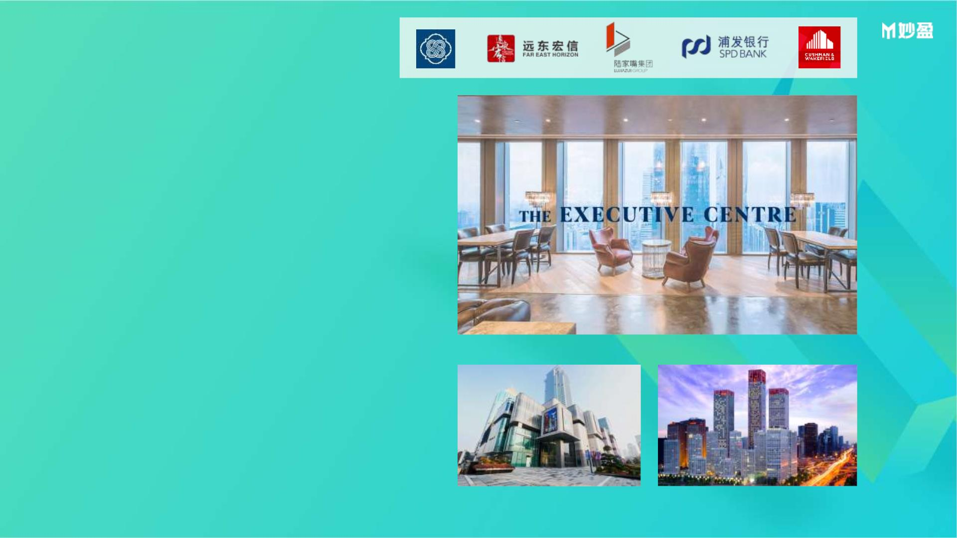
Use Case - Group
MioTech's carbon emission and energy digital intelligent management system has
been applied to more than 160 office buildings in The Executive Center. The
Executive Center is a provider of high-end office space solutions in the Asia-Pacific
region and the fourth largest serviced office brand in the world. Now, The Executive
Center has been established in 14 countries and 33 cities. The office network covers
Greater China, Southeast Asia, North Asia, India, Sri Lanka, Australia and the Middle
East. The group is committed to environmental protection design and management
and low-carbon processes to operate more than 165 office buildings around the
world, with a total business center area of more than 280,000 square meters.
MioTech provides carbon emission and energy digital intelligence management
systems for several office buildings of the group, helping the group to monitor the
status and trends of carbon emissions of each branch in real time and efficiently,
analyze major carbon emission loopholes, and take targeted intervention measures
in a timely manner ;Provide data basis and dynamic control for the group's overall
carbon emission reduction target formulation and carbon neutral path planning,
and at the same time accurately quantify the effectiveness of its own emission
reduction measures, and efficiently assist carbon neutral path planning and
decision-making adjustments; help the group Carry out multi-dimensional rankings
of carbon emissions and carbon emission reduction performance of each branch,
industry and regional benchmarking analysis, and best practice sharing to efficiently
manage the risks and opportunities of the entire group in terms of carbon
emissions.

Slide 17
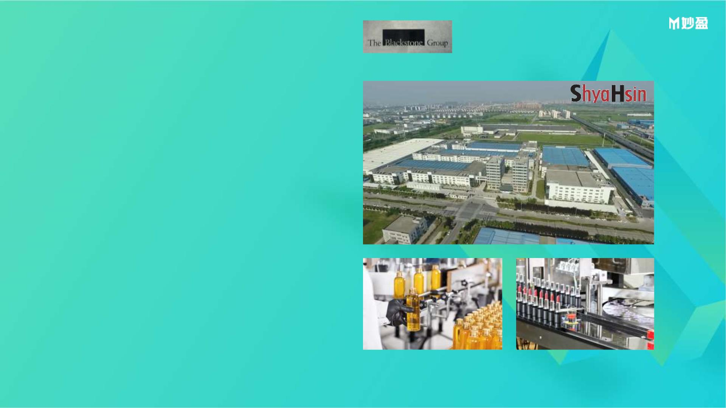
Use Case - Portfolio
Blackstone Group is a world-renowned private equity fund company, which has long
been committed to the carbon emission management and carbon neutral planning of
its investment portfolio. Miotech's carbon emission and energy digital intelligent
management system is applied to various manufacturing companies in the Blackstone
portfolio. Shyahsin Packaging Industry (China) Co., Ltd. (SHPC) is a typical
representative of them. Founded in 1970, the group has been specializing in the
production of cosmetic packaging containers for more than 50 years. It is a long-term
supplier of major cosmetic brands in Europe, the United States, Japan, South Korea and
other countries. The group is committed to becoming the world's leading cosmetics
packaging company with the least environmental impact through innovation and
operational excellence, and hopes to gradually reduce its greenhouse gas emissions by
improving energy efficiency.
MioTech provides digital and intelligent carbon emission and energy management
systems for many factories of the group, and realizes digital and intelligent carbon
emission and energy management through technologies such as IoT sensors, big data,
and artificial intelligence. Using the intelligent analysis function of the system, the
group has efficiently identified the leaks and energy efficiency improvement
opportunities of air compressors, injection molding machines, compressed air
equipment and other equipment and facilities in the factory, and has been able to
optimize the operation logic and model selection , frequency conversion control
upgrade and other targeted measures to improve energy efficiency and avoid waste,
so as to achieve the effect of reducing energy consumption per unit of output and
carbon emissions.

Slide 18
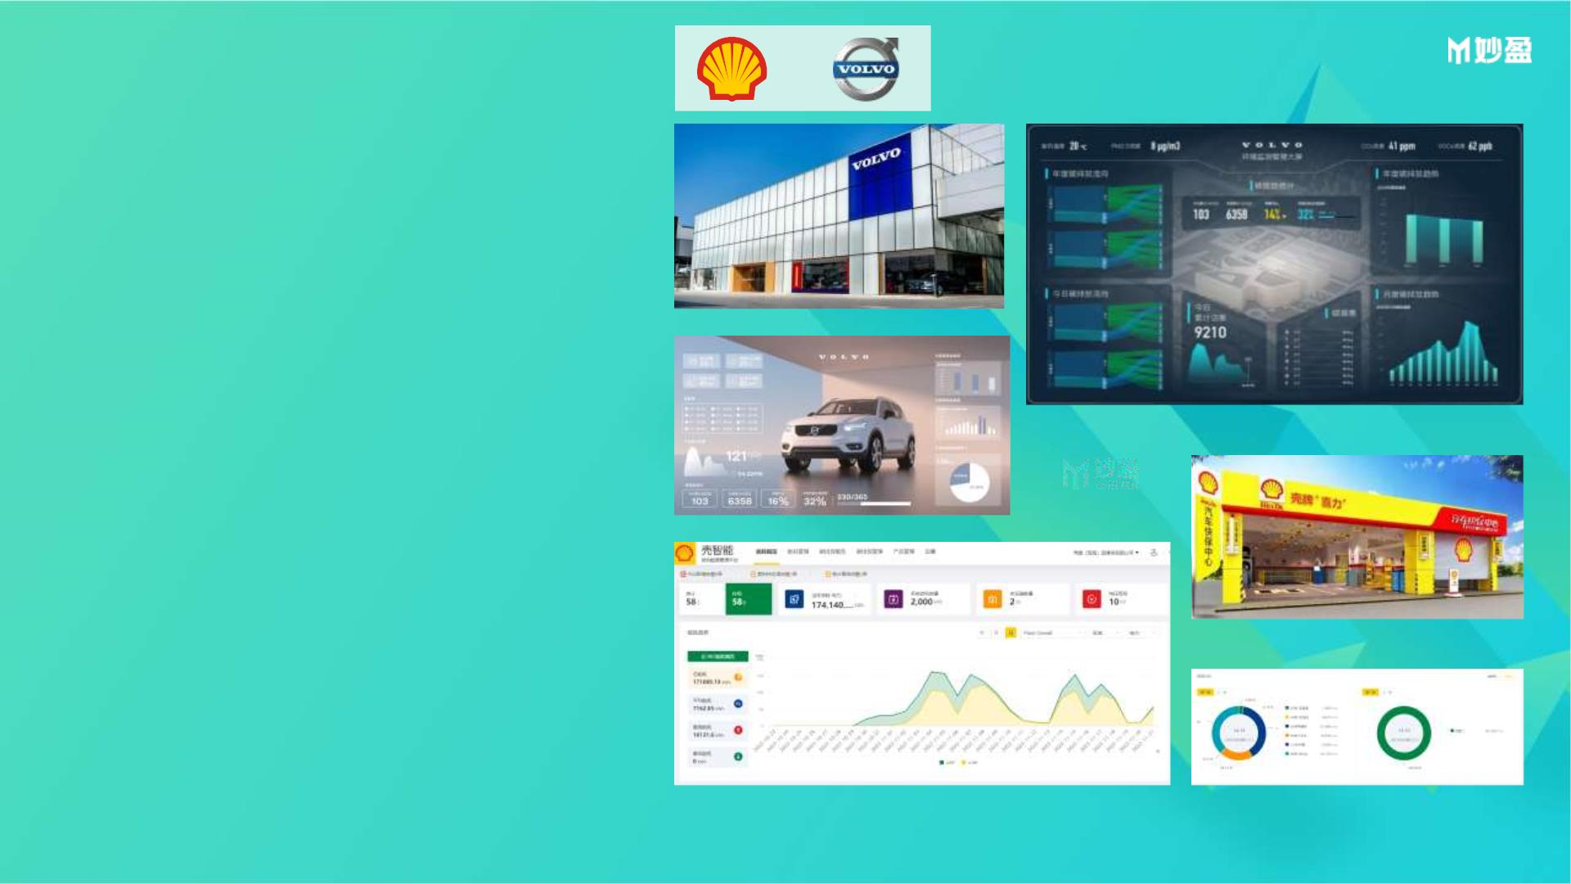
Use Case - Supply Chain
As the world's leading manufacturing companies, while formulating and
implementing their own carbon neutrality goals, Shell and Volvo Group
are committed to leading their supply chains to jointly reduce carbon and
approach the goal of supply chain carbon neutrality.
Miotech provides carbon emission and energy digital intelligence
management systems for Shell and Volvo Group's own factories, office
buildings, stores, and their suppliers, helping the Group and its suppliers
to monitor the status of carbon emissions of each enterprise in real time
and efficiently and trends, analyze major carbon emission loopholes, and
take targeted intervention measures in a timely manner; provide data
basis and dynamic control for the formulation of the overall carbon
emission reduction goals of the supply chain and the planning of carbon
neutral paths, and accurately quantify the effectiveness of its own
emission reduction measures Efficiently assist in carbon neutral path
planning and decision-making adjustment; assist in the multi-
dimensional ranking of carbon emissions and carbon emission reduction
performance of various companies in the supply chain, industry and
regional benchmarking analysis and best practice sharing, and efficiently
manage the carbon emissions of the entire supply chain risks and
opportunities.

Slide 19

EEIO - Economic Activity
Based Carbon Accounting
INNOVATE FOR A
ꢀ MioTech All Rights Reserved-Do not duplicate or distribute without permission.
SUSTAINABLE FUTURE

Slide 20
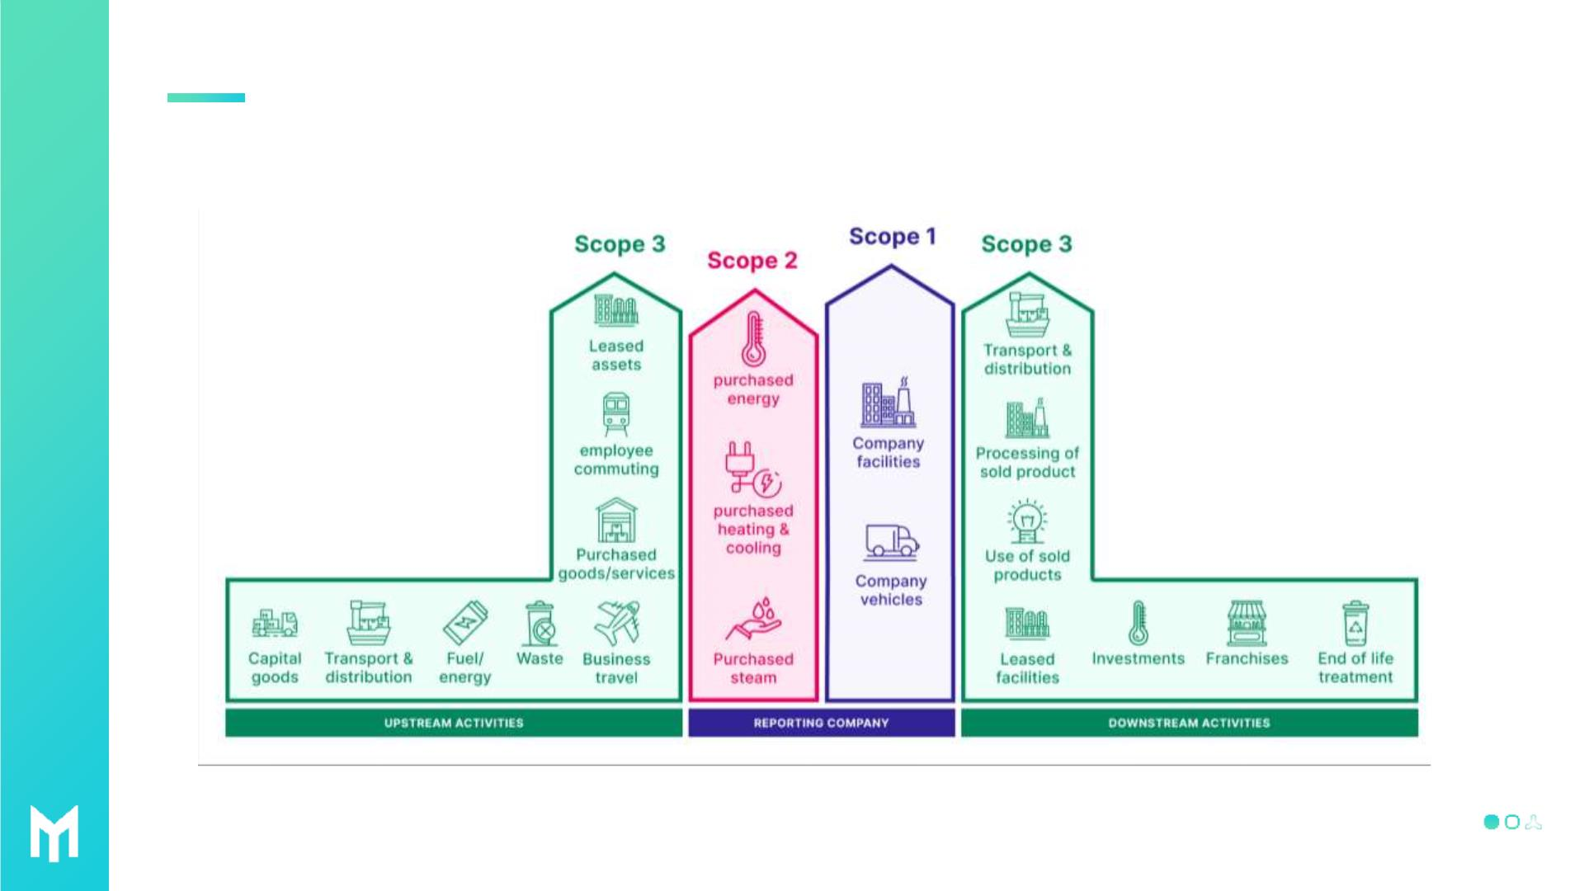
Scope 3 Carbon Accounting is a Headache
ꢀ MioTech All Rights Reserved-Do not duplicate or distribute without permission.

Slide 21
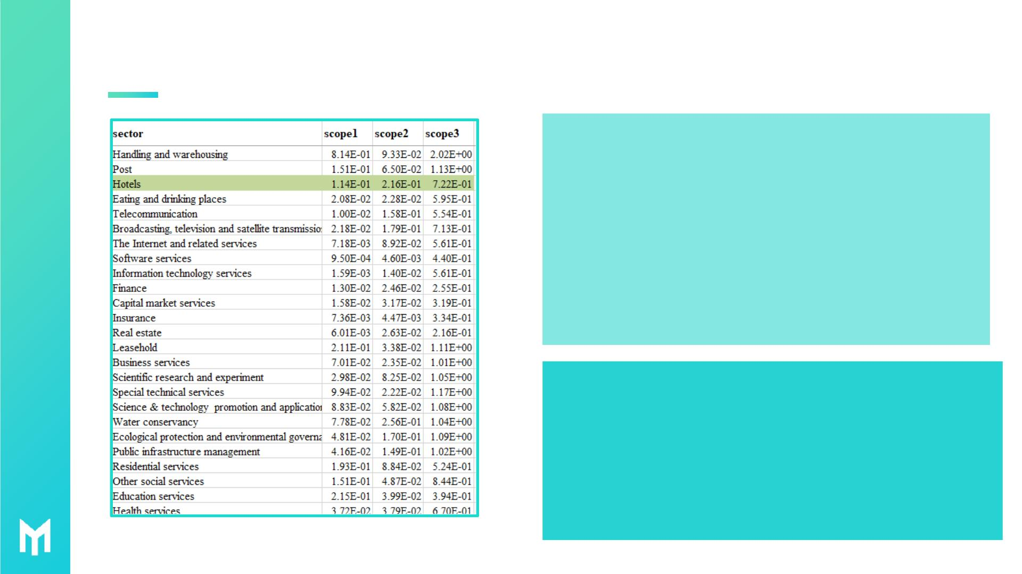
EEIO Model
When physical data are partly missing or not readily available, MioTech
recommends economic intensity to account for carbon emissions.
✓ MioTech emission factors reflects the total upstream carbon
emissions of the product
✓ The Hotel industry factor represents the emissions from various
upstream industries per 10,000 yuan, with unit of MTCO2/ten
thousand yuan.
✓ Hotel industry factors be split into Scope 1, Scope2 and scope3
Emission factors to meet multi-level disclosure requirements. In this
case. in order to be consistent with Sustainable Hospitality Alliance,
and the data in scope 1 and scope 2 are used for calculation.
✓ According to the actual situation of the hotel, EEIO specialists will
adjust correction factors to meet requirements of hotels from
different regions.
✓ Scope 1 refers to the carbon emission sources that
occur within the boundary of the hotel, such as natural
gas, diesel,etc.
✓ Scope 2refers to indirect emissions from purchased
electricity, steam, etc.
✓ Scope 3 refers to other indirect carbon emissions from
upstream of the supply chain, including purchased
goods, indirect electricity emissions, etc.
ꢀ MioTech All Rights Reserved-Do not duplicate or distribute without permission.

Slide 22

EEIO is a widely adopted methodology for carbon emissions and
environmental assessment
• EEIO is short for extended environmental input output, originated in the 1960s and 1970s and was proposed by Nobel laureate Leotif. EEIO
reveals the linkage of value and carbon emissions between various sectors in a national economy.International frameworks such as the
GHG Protocol, PCAF, TCFD, etc. suggest the use of EEIO in cases where activity data are missing or difficult to obtain.
• U.S. Environmental Protection Agency is one of the agencies applying the EEIO model. It aims to build bridges between economic
activities, sustainable development and environmental decision-making for the estimation of environmental impacts associated with
production activities or consumption activities. US EEIO is widely used by government agencies, corporations, non-profit organizations,
NGOs and academia for carbon footprinting calculations.
• Organizations such as S&P Trucost and Deloitte also use the EEIO modeling approach to provide data and environmental consulting
services.
• Large international corporations such as Amozon, General Motors , Facebook and others also use the EEIO methodology to estimate
their Scope 3 emissions.
ꢀ MioTech All Rights Reserved-Do not duplicate or distribute without permission.

Slide 23

International EEIO Databases
Exiobase
26 Countries/Regions, 43 Industries
WIOD
28 Countries/Regions, 35 Industries
EORA
40 Countries/Regions, 26 Industries
ꢀ MioTech All Rights Reserved-Do not duplicate or distribute without permission.

Slide 24

MioTech EEIO：Advantages
Wide
In-depth Analysis
Emission Composition Analysis,
Emission Intensity Analysis, etc.
Coverage
02
03
All industries covered for more
than 60 countries/regions, incl.
Norway, Sweden, Finland,
Denmark (ig. 153 industries for
China)
Authoritative
Data Source
Wide Application
Scenarios
01
04
National Bureau of Statistics,
Statistical Review of National
Energy, National Economic
Input-Output Table, etc.
Supply Chain Emissions, Product
Carbon Footprint, Financed
Emissions, Consumer Emissions,
etc.
ꢀ MioTech All Rights Reserved-Do not duplicate or distribute without permission.

Slide 25
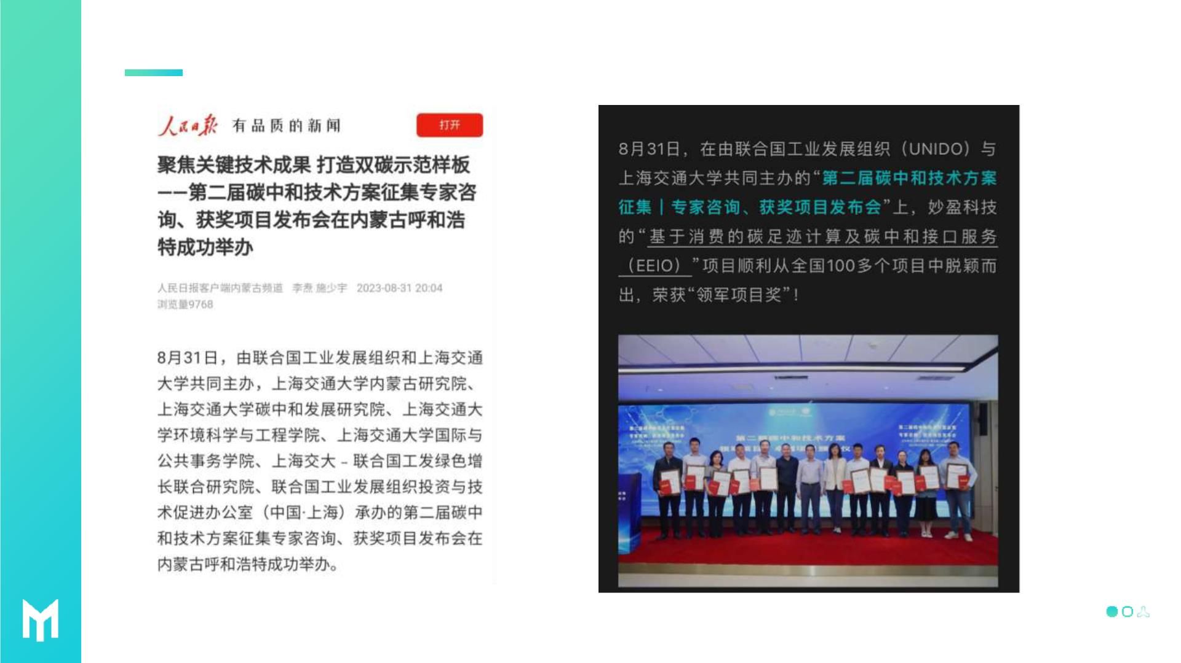
MioTech EEIO：Leading China
Mainland
ꢀ MioTech All Rights Reserved-Do not duplicate or distribute without permission.

Slide 26

Our datasets cover markets totaling over
trillion USD
sustainability
data
10
We serve clients with over
trillion USD in AUM
technology
o Asia
ꢀ MioTech All Rights Reserved-Do not duplicate or distribute without permission.

Slide 27

Open Discussion
1. What are the major driving forces behind your plan/endeavor
of decarbonization?
2. What are the major pain points along your decarbonization
journey?
3. Are you using digital systems in any part of your operation?
Are you suffering from any system defects?
4. More…
ꢀ MioTech All Rights Reserved-Do not duplicate or distribute without permission.

Slide 28

miotech.com
MioTech linkedin
ESGhub linkedin
ꢀ MioTech All Rights Reserved-Do not duplicate or distribute without permission.

