Slide 1
Sourcing Survey 2023
01 | Sourcing Survey
01.
Results from survey conducted 2023

Slide 2
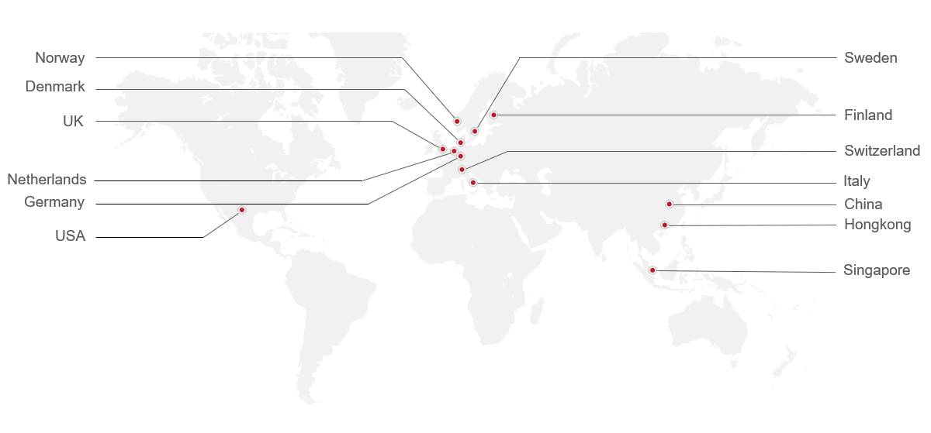
Respondents come from a diverse array of industries and over 33% have a purchasing value of over 100 million USD per year
Respondents in different classes of total global purchasing amounts in 2023
(Million USD)
The survey data cover the following topics：
Sourcing markets overview in China, Europe, and Southeast Asia
Current reshoring/nearshoring activities and trends
The role of ESG in sourcing
The future of sourcing and the perceived importance of different sourcing regions

Slide 3
Passing through the pandemic, China sourcing market is recovering while SEA market is growing significantly to catch up
Share of respondents who source in China
Share of respondents who source in SEA
78%
Yes
22%
No
49%
Yes
51%
No
Estimation of how large the purchase amount was in China and SEA
(2022-2023)
China
SEA
(0%-10%]
38
(10%-50%]
(50%-80%]
(80%-100%]
0
2022
2023

Slide 4
More companies have some sourcing in Europe, however a large group has only minor part of spend in Europe
Share of respondents who sourced in Europe
（2022-2023）
Estimation of how large the purchase amount was in Europe
Survey respondents listing top 3 countries they source
Notes:
As most companies are headquartered in Europe, the majority of companies also source in the region and most have sourcing activity in Germany.
The companies’ purchasing spend in Europe follow a similar share distribution as China. Most spend between 10% - 49%. Notable difference is that a higher share spend between 50%-79% in Europe, a possible indication that companies’ European sourcing is growing in importance.

Slide 5
China and Southeast Asia have much sourcing for pure exports, while Europe normally supplies local and global demand
China is mainly identified as a market for global supply
SEA mainly serves global demand while Europe supplies both local and global demand
Main reason for sourcing in China, share of the respondents
(2019-2023)
Main reason for sourcing in SEA and Europe,
share of the respondents
(2021-2023)
Notes:
Most respondents recognize that China is mainly a market for their global supply
Chinese market has become less important for companies’ global sourcing needs after the pandemic
Southeast Asia mainly serves global production demand though there has been a notable shift toward serving the local region
Europe s also the main destination where their purchased materials are consumed whilw this tendency becomes less distinctive than last year

Slide 6
The recovery of sourcing in China didn’t dull companies’ growing confidence in SEA
Recovering confidence toward the Chinese market
Share of respondents’ likeliness to relocate their sourcing out of China
Growing confidence in SEA market when compared with China
Share of respondents’ likeliness to relocate their sourcing out of SEA

Slide 7
Costs pressure reduced compared with last year, but remains top concern
Share of respondents listing their perceived top three risk factors
Increasing costs
Increasing cost
Increasing cost
1
1
1
2022
2023
-21%
2022
2023
-7%
2022
2023
-17%
65%
44%
85%
78%
57%
40%
Unstable suppliers
performance
Production capacity
Unstable suppliers performance
2
2
2
2022
2023
-9%
2022
2023
3%
2022
2023
-13%
38%
29%
26%
29%
43%
30%
Increased tariffs
Currency risks
Lack of suppliers skills
3
3
3
2022
2023
9%
2022
2023
10%
2022
2023
3%
15%
24%
8%
18%
20%
23%
Notes:
Increasing costs was the most significant risk factor for sourcing in all three regions.
Unstable supplier performance is regarded as the second most concerning factor for sourcing in China and Southeast Asia.
Production capacity rose from the fourth to the second biggest concern for companies sourcing in Europe with 29% of respondents concerning it. The increased mention may be due to Europe’s energy crisis last year which significantly hindered the manufacturing sector in Europe.

Slide 8
Supply Chain situation has improved significantly, Cost pressure, logistics disruptions and lead time are a concern for fewer
Top sourcing problems
1
The three biggest challenges that companies have faced in 2023 remain the same as those of previous years.
On average, the concerns over the top three problems declined by about 30% between 2022 and 2023
2023
59%
-26 %
Increasing costs
85%
2022
2
2023
41%
-33 %
Logistical disruption
74%
2022
3
2023
32%
-36 %
Longer lead time from suppliers
68%
2022

Slide 9
Cost is still the biggest criteria when companies decide whether to relocate
Top Reasons for relocating
1
The decline in the share of may partly attribute to the reopening of China.
Companies today, looking back at the challenges posed in recent years, have realized the importance of diversifying their supplier base into more markets to help mitigate potential risks.
Many companies reshore or nearshore to strengthen control of logistics by shortening the shipment distance
2023
60%
-3 %
Cost saving
63%
2022
2
2023
39%
-2 %
Risk mitigation
41%
2022
3
2023
26%
-20 %
Improved logistics and distribution
46%
2022

Slide 10
Quality and insufficient knowledge have decreased as perceived barriers of entering new sourcing markets
Quality Risk
Insufficient knowledge about the new market
Set-up Costs
2023
2023
2023
37%
-12%
32%
-8%
31%
4%
2022
2022
2022
49%
40%
27%
The most significant barrier
Performing extensive quality controls of new suppliers is a costly but necessary measure to take to ensure that the requirements are met.
Companies may benefit from hiring a local resource or appointing consultants with market insights to support the entry.
The cost may involve market research expenses, marketing expenses, supplier searching and training expenses
Each of these costs needs to be carefully considered and budgeted.

Slide 11
Significantly more companies started to assess suppliers’ carbon footprint data
Share of the respondents assessing suppliers’ carbon footprint in 2023 compared with 2022
75%
75%
70%
The share of companies assessing suppliers from three regions increased significantly
2022
57%
2023
40%
35%
China
Europe
SEA

Slide 12
Companies assess sustainability performance, but many struggle with data collection
Extent of the respondents assessing current and new suppliers’ carbon footprint data in 2023

Slide 13
Assessing Fair Labor conditions is more mature and most are able to receive needed data
Positive treatment of all employees including favorable pay and benefits in excess of mandated minimums. This includes fair employment consideration for all individuals regardless of personal differences.
High percentage of assessing in fair labor data points to this issue received high degree of awareness in Europe
Fair Labor
Share of respondents assessing fair labor data of suppliers
2%
0%
Enough to ensure that we follow the local regulation standards
We do not assess it
According to our customers’ requirements
Suppliers do not provide data when asked
According to our own internal ambitions that exceed customers’ minimum requirements
I do not know

Slide 14
Governance: Corporate integrity of suppliers is a topic that has received less focus
Across three regions, nearly 25% of companies went and beyond the requirements of the customers, while a large portion in each do not know
Corporate Integrity
Share of respondents assessing corporate integrity data of suppliers
0%
0%
0%
Enough to ensure that we follow the local regulation standards
We do not assess it
According to our customers’ requirements
Suppliers do not provide data when asked
According to our own internal ambitions that exceed customers’ minimum requirements
I do not know

Slide 15
Five common strategies to ensure suppliers’ ESG compliance
On-site visit to the suppliers' facilities
Review of data and documents suppliers provide
Conduct third-party Audit
Interview with experts and/or suppliers' staff
Review of media reports about the suppliers
1
2
3
4
5
58% respondents adopted
46% respondents adopted
42% respondents adopted
22% respondents adopted
13% respondents adopted

Slide 16
Respondents show growing confidence in SEA and Europe, but China remains highly important
Share of respondents' perception of regions’ importance as a sourcing market
Year 2022
Year 2023
China
58
The trend of conducting sourcing activities in Europe has accelerated faster than in SEA
SEA receives more favorable responses than last year
Despite lacking the market confidence, China still hold the leading position as the most prominent sourcing destinations
38
SEA
48
57
38
Europe
More Important
9
Same Importance
Less Important
Share of important sourcing destinations in the future

Slide 17
China is the most popular destination for new sourcing activity followed closely by Southeast Asia and Europe in the past 12 months
90% of the respondents who took the survey have started new sourcing activities across China, Southeast Asia, and Europe.
China is the most popular sourcing destination
Despite China remaining the primary destination, Southeast Asia and Europe are gaining attraction as the next big sourcing markets.
Respondents shared the new sourcing activity in the last 12 months
35%
27%
28%
Have new sourcing in China, SEA, and Europe
China
SEA
Europe
No new sourcing in China, SEA, and Europe

Slide 18
Different risk mitigation strategies that respondents adopted
The majority of companies plan on diversifying their supplier base to another country as a risk mitigation strategy
Enhancing communication with current suppliers helps ensure that orders are fulfilled and prepare for any risks that might be approaching.
Diversifying the suppliers base to other countries
Enhancing communication with suppliers
Developing new risk management processes while continuously tracking changes
44% Respondents adopted
38% Respondents adopted
24% Respondents adopted

Slide 19
Summary
China remains a key sourcing market, yet about 30% of respondents indicated plans to relocate at least parts of their sourcing within the upcoming year. Nevertheless, few other markets offer the same competitiveness, and many companies are staying in the country as of now.
Southeast Asia and Europe are expected to be equally important sourcing locations for companies as China.
The key reasons companies are looking at alternative sourcing markets include cost savings, improved logistics, distribution capabilities, and risk mitigation. The main barriers companies face when entering new markets include quality risks, insufficient knowledge, and production capability risks.
Companies are more likely to attain and assess data regarding fair labor and corporate integrity than carbon footprint, pointing to a lack of awareness toward sustainability metrics that are not immediately and visibly urgent.
Companies much on own factory visits to assess the suppliers’ sustainability performance.

Slide 20
China Market Overview
02 | China Market Overview | Economy Snapshot |
02.
Economy Snapshot | M&A Translation | Policy Overview | Summary

Slide 21
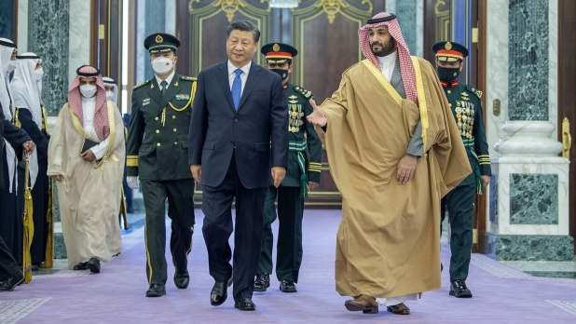
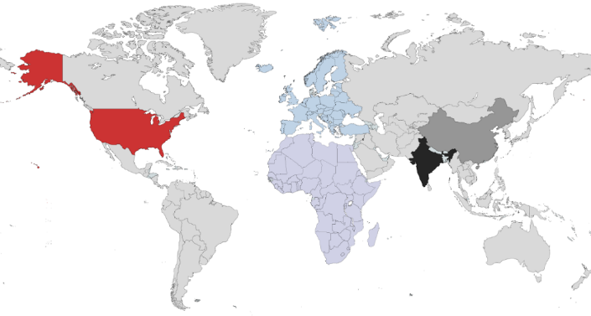
02 | China Market Overview | Economy Snapshot
China
Economy Snapshot
Europe 132
China 219
China is already the world’s largest economy in terms of GDP adjusted for purchasing power parity (PPP). In H1 2023, China is adding an economy the size of Central America to its GDP.
An Increasingly Polarized Global Economy
Impact of Valuations
US
656
China
172
April 2023, Bangladeshi transfer to Russia in CNY for nuclear power plant.
Oil & Gas Settlements in CNY
EU 163
India 118
In 2018, China Minted 1 Unicorn per 3.8 Days
Source: Household debt to GDP: IMF GDP Growth per Quarter: Statista Unicorns by country: Traxn
Notes:
- Dollar starting to slip - CIPS system

Slide 22
02 | China Market Overview | Economy Snapshot | Decoupling?
China
Decoupling?
Europe 132
China 219
The import figures from China to the US indicate a certain degree of decoupling, with new highs particularly evident in areas unaffected by trade war tariffs. Conversely, China is witnessing increased exports to countries participating in the Belt and Road Initiative.
Intended Results of Trade War - Questionable
China Friend-Shoring – Seeks to Consolidate Trade with OBOR Countries
US Imports from China by Trade War Tariff (USD billion)
+41%
Source: US imports from China are both decoupling and reaching new highs. Here's how. | PIIE China Bureau of Statistics

Slide 23
02 | China Market Overview | Economy Snapshot | Public Debt Causing Concerns
China
Public Debt Causing Concerns
Europe 132
China 219
China’s infrastructure spending and COVID-19 response have resulted in notable levels of debt accumulation within local governments, concurrently introducing fiscal challenges that need to be addressed for sustained financial health.
Local Government Debt - LGFVs
Local Government Land Revenue Declining
20%
Central Government
30%
Local
37.8%
LGFV Est. 9b USD (9% maturity this year)
30%
50%
Guizhou province stands out as the most heavily indebted region in China, with its financial landscape reflecting a notable complexity. Its GDP-to-debt ratio, currently at 62%, paints a picture of substantial fiscal commitments relative to its economic output. Yet, a significant facet of concern lies in the off-balance sheet debt, which might exceed an astonishing 140%.
CNY trillion
Source: US imports from China are both decoupling and reaching new highs. Here's how. | PIIE

Slide 24
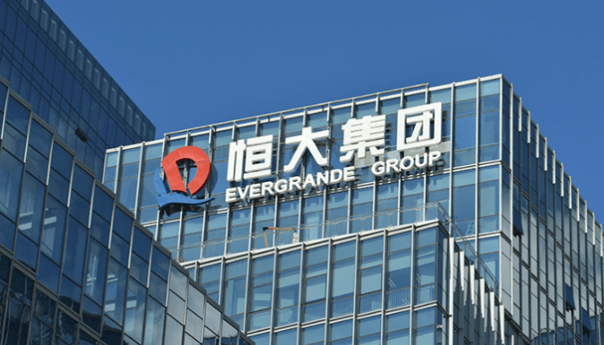
02 | China Market Overview | Economy Snapshot | An Immediate Crisis?
China An Immediate Crisis?
Europe 132
China 219
New Property Developments on Hold (YoY Comp.)
Households Remains Relatively Robust
Growing Deposits Rate
Local Developers & Lenders Causing Concerns
Source: Investment in Real Estate Development from January to July 2023 (stats.gov.cn)

Slide 25
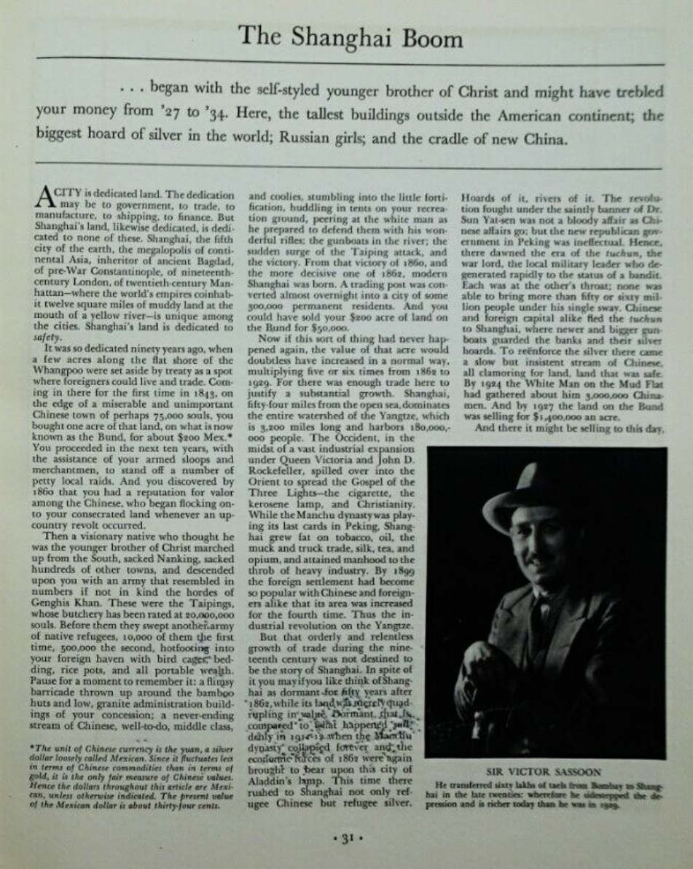
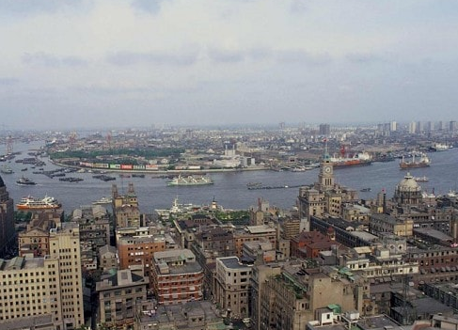
02 | China Market Overview | Economy Snapshot | Historic Real Estate Bubbles
China
Historic Real Estate Bubbles
Europe 132
China 219
“Why Shanghai Is The Most Obvious Real Estate Bubble Ever” - “One clear clue (regarding the rising real estate prices in China) is that the average price-to-income ratio in Beijing has reached 27:1, five times the world average, according to data from the Bureau of Statistics of the Beijing Municipality. In addition, the average price-to-rent ratio neared 500:1 in the city, far above the international alarm threshold of 300:1, which sends out a clear signal that the foundation of the real estate boom is losing stability.” – Business Insider 2010
Shanghai 1930s
Shanghai 1990s
Source: Fortune Magazine 1932 https://www.businessinsider.com/the-chinese-real-estate-bubble-is-the-most-obvious-bubble-ever-2010-1#there-are-also-demographic-factors-6

Slide 26
Cross-Border M&A
Geopolitical Events Impacts Deal Numbers
02 | China Market Overview | Economy Snapshot | Geopolitical Events Impacts Deal Numbers
Policies Creates Long-Term Impact on M&A Transactions
Latest Transactions Pending
Acquirer | Date | Transaction Status | Transaction Value (MM) | Target Country | Target
Oriental University City Holdings HK Ltd. | Jul-2023 | Pending | 12.81 | Singapore | 4 Vellees Pte. Ltd.
AAC Technologies (Belgium) BV | Aug-2023 | Pending | 524.61 | Netherlands | Acoustics Solutions International BV
ADAMA Ltd. | Mar-2023 | Complete | 17.00 | Chile | ADAMA Chile (60%)
Armour Energy Ltd. | Aug-2023 | Pending | 252.83 | Australia | Shunkang Holding Group
Aston Martin Lagonda Global Holdings Plc. | May-2023 | Pending | 173.63 | United Kingdom | Zhejiang Geely Holding Group Co., Ltd
VCREDIT Holdings Ltd. | May-2023 | Pending | 37.67 | Portugal | Banko Portogues
Gravitas Education Holdings, Inc. | Apr-2023 | Pending | 750.00 | Cayman Islands | Best Assistance Education Online Ltd.
Suzhou Basecare Medical Corp. Ltd. | May-2023 | Complete | 40.00 | Singapore | BMX Holdco Ltd
NaaS Technology, Inc. | Aug-2023 | Pending | 66.03 | Sweden | Charge Amps AB
Shenzhen Mindray Bio-Medical Electronics Co., Ltd. | Jul-2023 | Pending | 126.91 | Germany | Diasys Diagnostic Systems
Shanghai Electric Power Co., Ltd. | Feb-2023 | Complete | 41.38 | Hungary | Greencells GmbH
Dehong Capital Partners Ltd. | Jun-2023 | Pending | 30.68 | South Korea | GRI Energy
Hainan Mining Co., Ltd. | Jan-2023 | Complete | 112.00 | Mali | Kodal Minerals Plc
Milkyway International Chemical Supply Chain Pte Ltd. | Jun-2023 | Pending | 37.45 | Singapore | LHN Logistics Ltd.
Meituan | Jun-2023 | Pending | 284.36 | United States | Lightyear AI
Sinomine Resource Group Co., Ltd. | Feb-2023 | Pending | 20.00 | Mongolia | Lithium Century
Victory Giant Technology (HuiZhou) Co., Ltd. | Jul-2023 | Pending | 457.18 | Singapore | MFS Technology Ltd.
Indo Pacific Net Zero Battery-Materials Consortium | Feb-2023 | Complete | 31.00 | Indonesia | Mineralindo Morowali
Zhongrun Resources Investment Corp. | Mar-2023 | Pending | 96.35 | British Virgin Islands | New King International
ACM Research (Shanghai), Inc. | Feb-2023 | Pending | 16.70 | South Korea | Ninebell Co. ltd
SC Autosports LLC | Jun-2023 | Pending | 16.12 | United States | Northerngroup Inc
Huaxin (Hong Kong) International Holdings Ltd. | Jun-2023 | Pending | 265.00 | South Africa | NPC Cemor
Huaxin Cement Co., Ltd. | Mar-2023 | Complete | 193.10 | Oman | Oman Cement
Westland Milk Products Investments Ltd. | Jun-2023 | Pending | 18.88 | New Zealand | Ausnutria Dairy Corp. Ltd.
Inova Automation Co., Ltd. | May-2023 | Complete | 32.43 | South Korea | SBC Linear
China Cross-Border Transactions US & EU
Trade War Starts
OUTBOUND
Covid-19
Ukraine War
INBOUND
Lockdown
Sources: Factset, ARC`s inhouse research
Notes:
Stricter guidelines for overseas investment
Capital controls

Slide 27
www.arc-group.com

