Slide 1
MioTech
Innovate for a Sustainable Future

Slide 2
01
Products & Services

Slide 3
Products & Services
Full Suite of Sustainability Solutions
Net Zero Consulting
Carbon & Energy Asset Management
Emissions Monitoring System
Individual Carbon Footprint
Corporate Engagement
Hong Kong+Singapore+Shanghai+Beijing
China
03
04
01
02
Green Community
Capital Markets
ESG
CarbO₂n
Financial Institutions & Investors
Corporates & Supply Chain
Indices
Pre-IPO Sustainability Advisory
Methodology, Ratings & Data
Hong Kong+Singapore+Shanghai+Beijing
Hong Kong+Singapore+Shanghai+Beijing

Slide 4
01 ESG
Corporates & Supply Chain
—For Corporations
ESG Consultancy Services
World’s leading ESG network
Level Up Your ESG Performance
Clear, Comparable, Consistent ESG Disclosure
ESG and Corporate Social Responsibility Disclosure
Green financial, Responsible Investing, and Supply-chain ESG Due Diligence
Collect ESG data across subsidiaries, business units, and supply chain.
Analyze ESG performance and benchmark against industry peers.
01
04
Establishing ESG Management Policies and Infrastructure
ESG Training and Investor Relations
02
05
Share or request ESG disclosures with key stakeholders.
Report & comply with regulator or international standards.
Engage third-party ESG services.
Connect with industry players.
Climate Change Response and ESG Goal-setting
Capital Market ESG Performance and Financing
03
06

Slide 5
02 CarbO2n
Carbon & Energy Management
Net Zero Consulting
Emissions Monitoring
01 Carbon Footprint Analysis
02 Climate Transition Feasibility & Strategy
03 Net Zero Due Diligence and Road mapping
04 Implementation
01 Real-time IoT data capture
02 Intuitive MRV system
03 AI-enabled analytics
Net Zero Consulting
Emissions Monitoring
Carbon
Asset Management
Decarbonization
Carbon Asset Management
Decarbonization
01 Product Lifecycle Analysis
02 Energy-optimizing materials
03 Develop GHG and Energy infrastructure
01 Develop Carbon Credits
02 Trade Carbon Credits

Slide 6
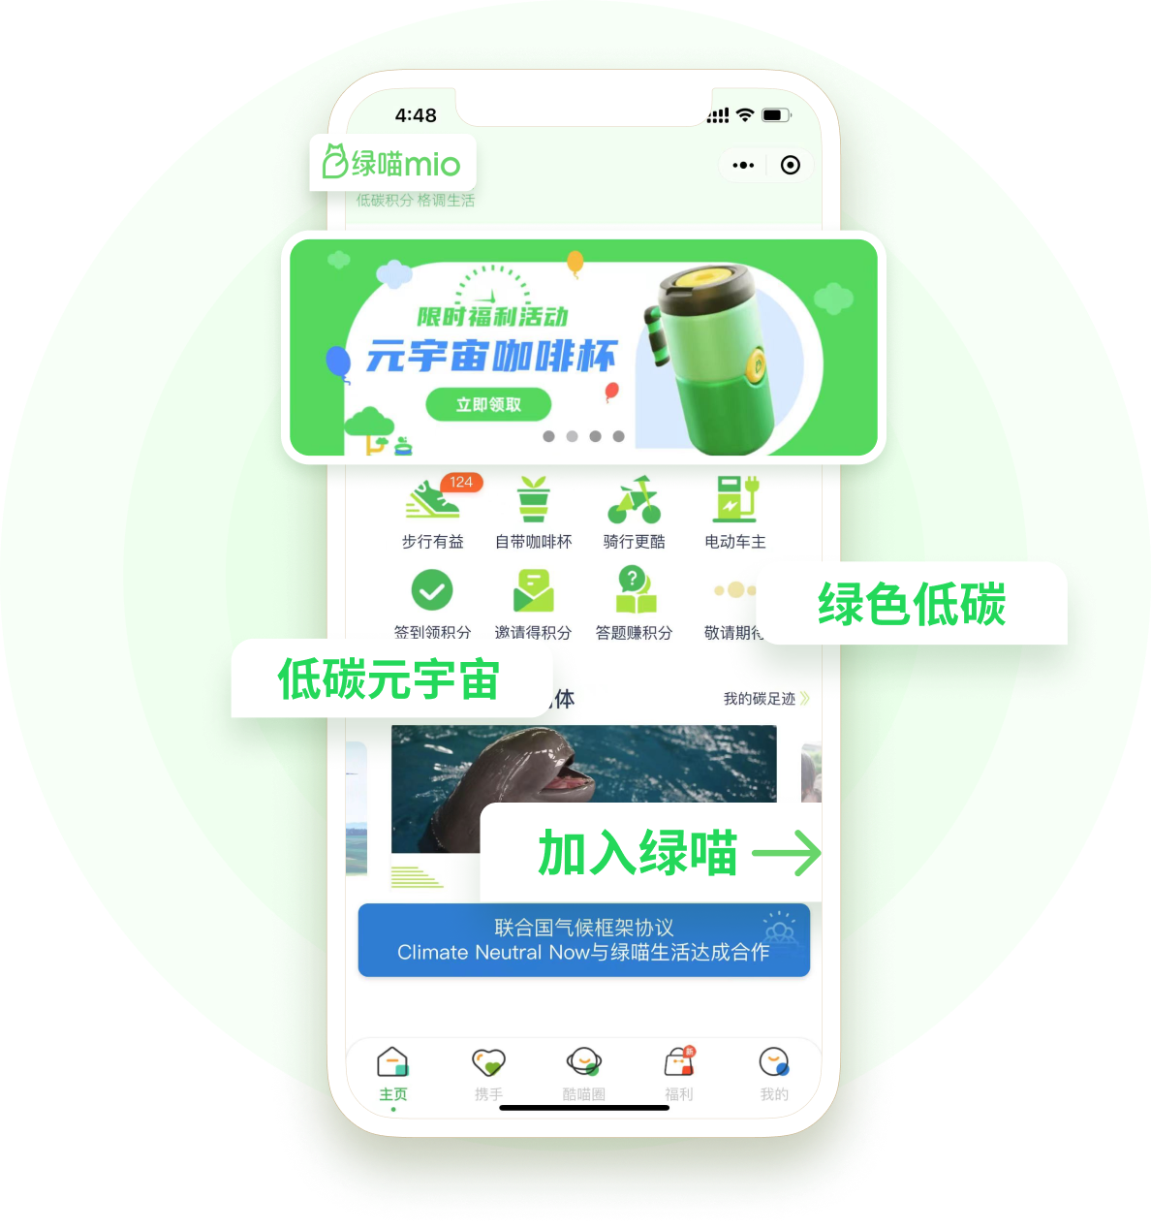
03 Green Community
mio App
Gamifies green living by incentivizing sustainable choices.
01.
mio Points & Rewards
Community Participation
Promote greener, cleaner consumer choices
02.
Low-carbon Advocacy
03.
Community Engagement
Corporate Engagement
Stimulate top-down corporate social responsibility participation
04.
Corporate Challenges
Social Inclusion
Construct eco-conscious communities
05.
mio Carbon Calculator

Slide 7
02
Client Testimonials

Slide 8
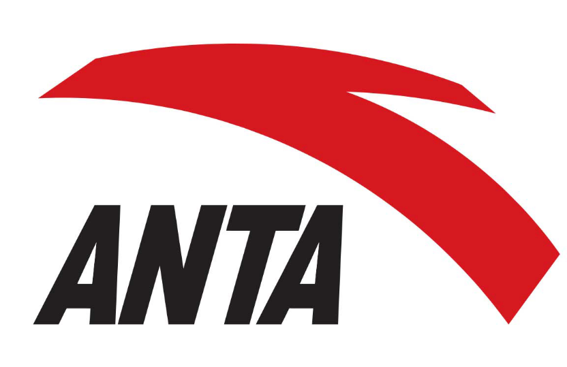
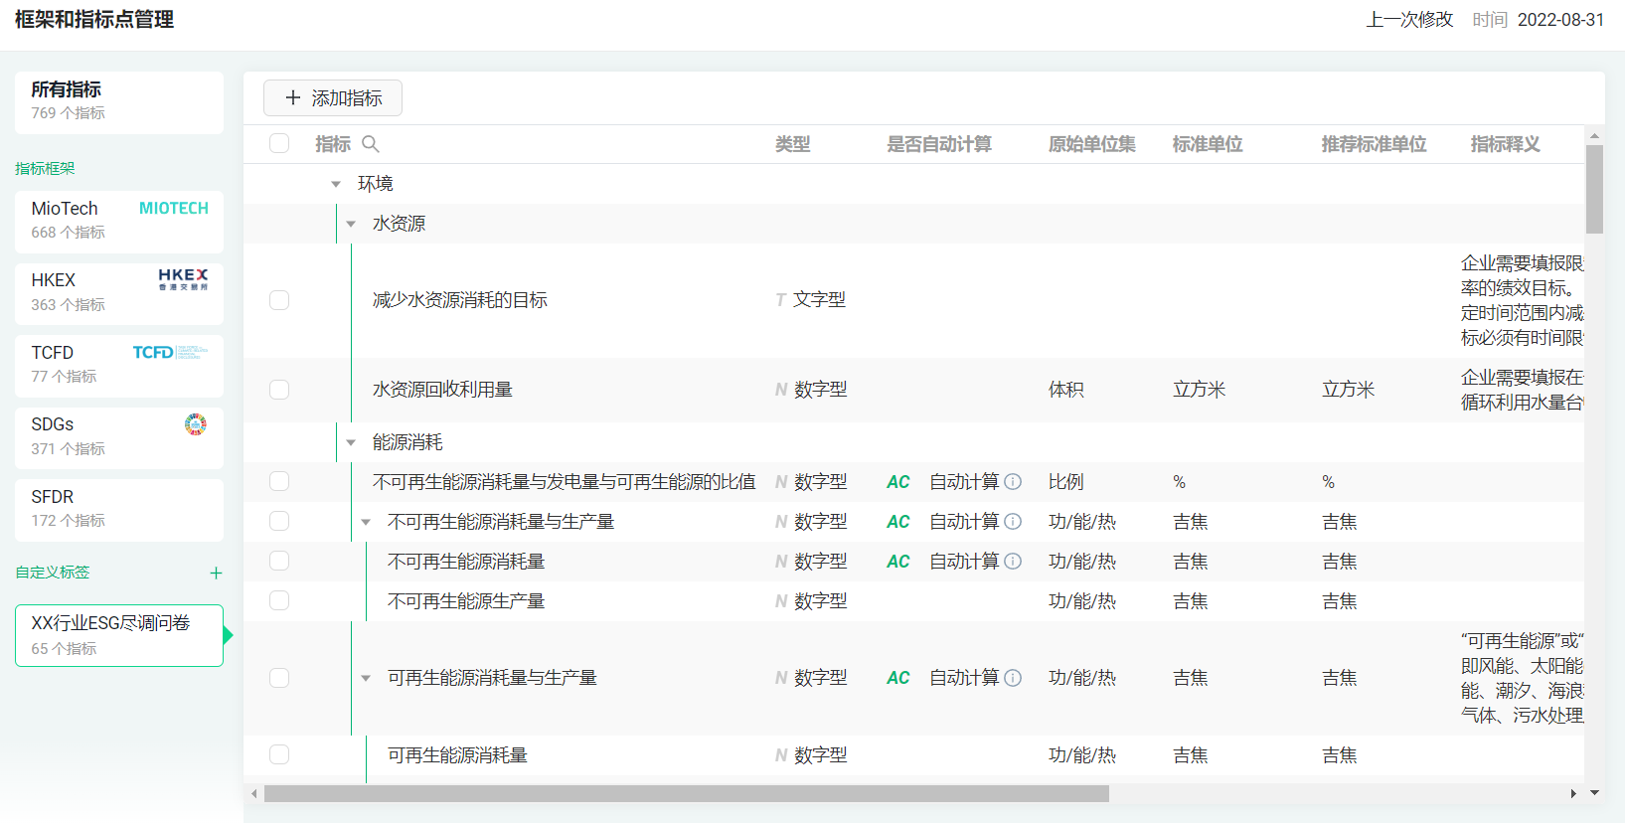
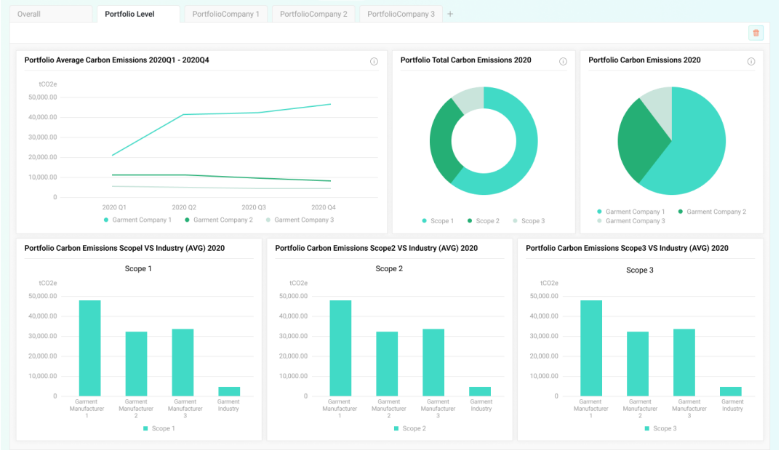
Client Testimonials
ESG Data Management Platform
World’s leading ESG platform in data management, visualization, reporting, benchmarking and connecting
MioTech Solutions for Anta
Manage its ESG data in a more efficient and effective way
Compare ESG performance to peers across industries and geographies.
Identify best practices, improvement opportunities, and detect market trends and risks.
Increase data accuracy, quality and traceability, and prepare for ESG data audit.
Visualize data, establish ESG roadmap and help with operational strategies

Slide 9
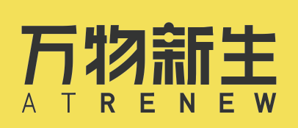
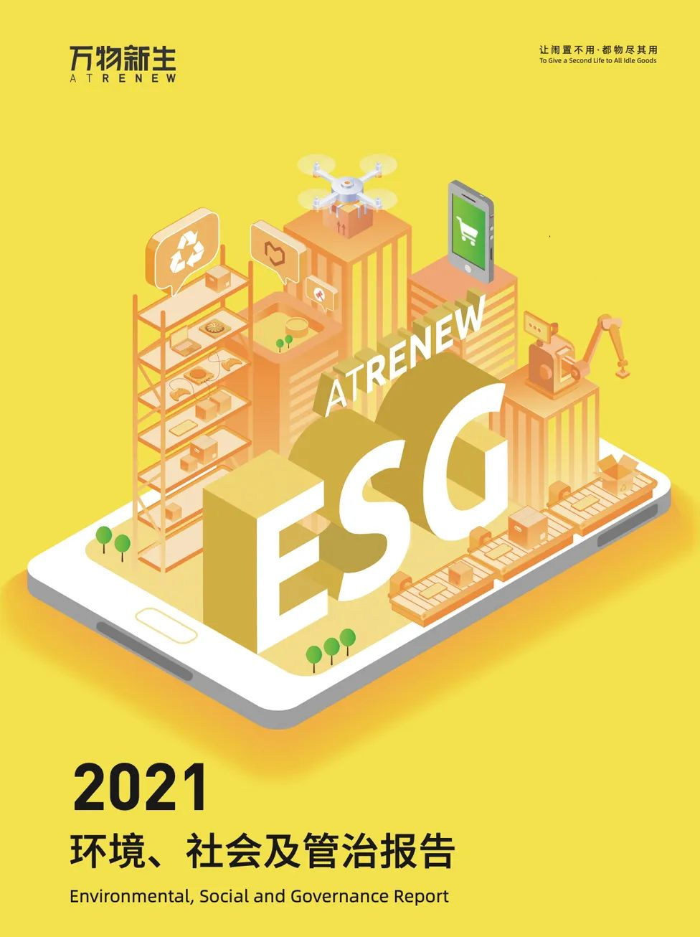
Client Testimonials
ESG Consulting + Product Carbon Lifecycle Analysis
We look forward to continuing our partnership with MioTech in carbon emissions reduction. Today, sustainable business practices is essential for companies, the wider industry, and society.
——Kelvin Qian, ATRENEW Vice President
MioTech Solutions for ATRENEW
MioTech’s expert consulting team supported ATRENEW to publish their "2021 Environmental, Social and Governance Report.”
Adopted MioTech’s product life-cycle analysis to quantify carbon emissions reduced per recycled smartphone.
Utilized MioTech’s circular footprint calculation formula to estimate overall emissions reduction of smartphone recycling, shown to be 460,000 tons in 2021 – equivalent to 230 million sqm of urban forests.

Slide 10
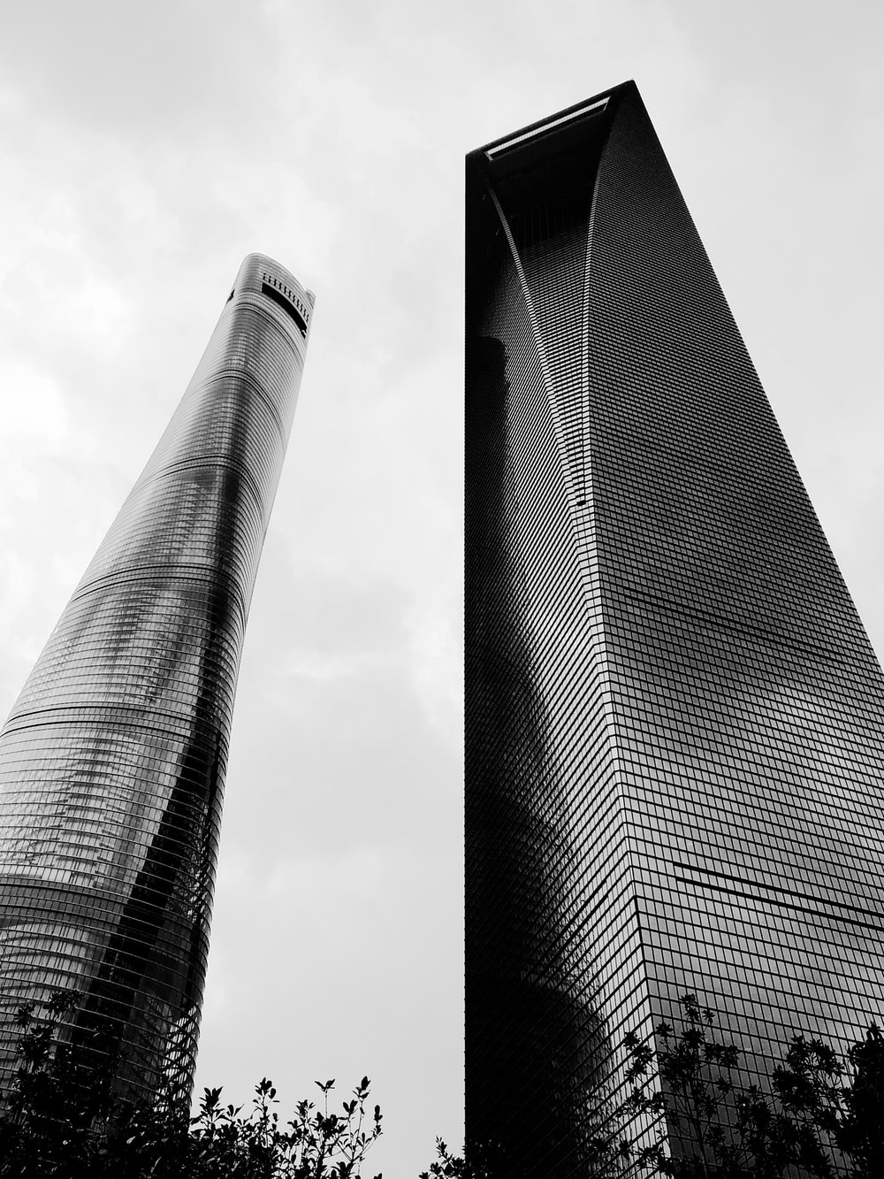
Client Testimonials
Sustainable Property Management
Shanghai Tower, one of China’s first eco-conscious offices, has signed a strategic partnership agreement with MioTech to improve sustainability practices.
MioTech Solutions for Shanghai Tower
Estimate carbon emissions
Emission reduction solutions tailored towards local and regulatory standards
Comply with disclosure requirements
Formulate net-zero roadmap
Shanghai Tower, China’s first skyscraper, has industry-leading green infrastructure. Our strategic partnership with MioTech enables us to meet our low-carbon objectives and formulate our long-term sustainability vision.
——Sun Jun, Director of Engineering for Shanghai Tower

Slide 11
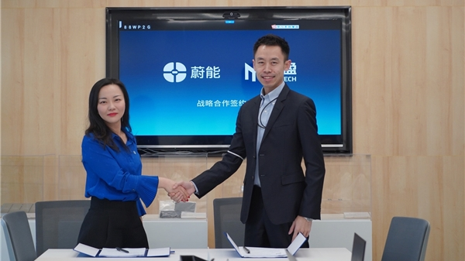
Client Testimonials
Carbon Asset Management
Carbon Inventory
Intelligent Energy Management
Carbon Footprint Analysis
Carbon Credit Development
MioTech provided:
Our strategic partnership has not only enabled us to develop innovative operation models with technological improvements but also conduct industry-leading research in GHG emissions reduction.
Carbon inventory due diligence
Carbon footprint analysis
Carbon credit development solutions
————Xue Tingting, Chief Operating Officer

Slide 12
MioTech
Innovate for a Sustainable Future

